Slide 1
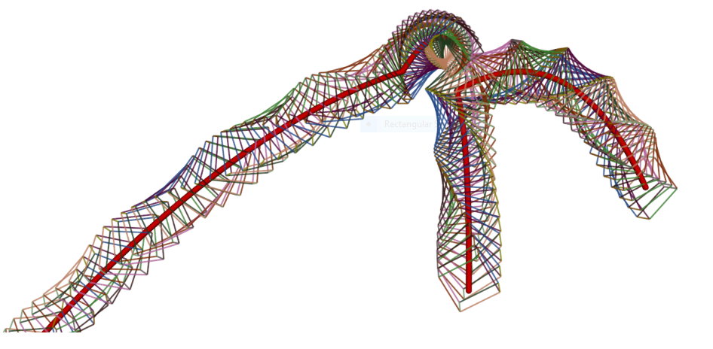
Rigid Body Motion from Video
Pratik Kalshetti - 163050048 Naman Rastogi - 163050056

Slide 2
Problem Statement
Input:
A video depicting collision of objects
Output:
Reconstructed physically valid collision

Slide 3
Applications
Entertainment – Test collision without damaging real objects
Estimate physical quantities – Coefficient of restitution of new objects

Slide 4
Solution Approach
Read collision parameters directly from input video
Position – locating object centroids in keyframes
Orientation – try various rotations of pre-scanned object in 3D, render, choose the one that matches the closest
Rigid body physics simulation
Enforce constraints based on above parameters

Slide 5
Implementation
Assumptions
Perfectly rigid body
No external force (except gravity)
Libraries
OpenGL – Rendering
Bullet – Physics Simulation
Method
Initialize the scene – parameters are given manually
Run the physics simulation, and render simultaneously

Slide 6
Next…
Read parameters from video
Enforce constraints in simulation

